Slide 1
Let’s talk about chatGPT

Slide 2

Technology Breeds Change

Slide 3

The “chat” of chatGPT
Tell me about…
?
Do all of my work
Good
Bad
Basically a search engine
Constructive use
Plagiarism

Slide 4
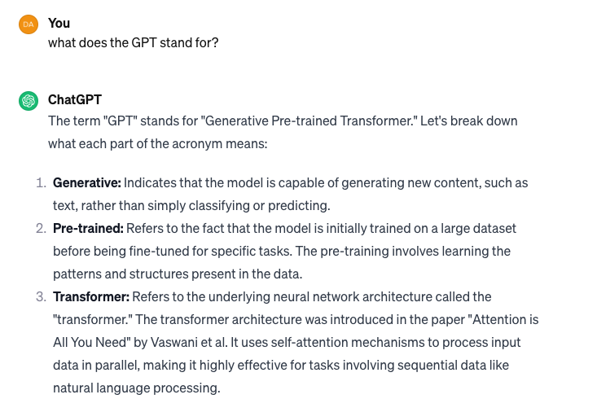
The GPT

Slide 5
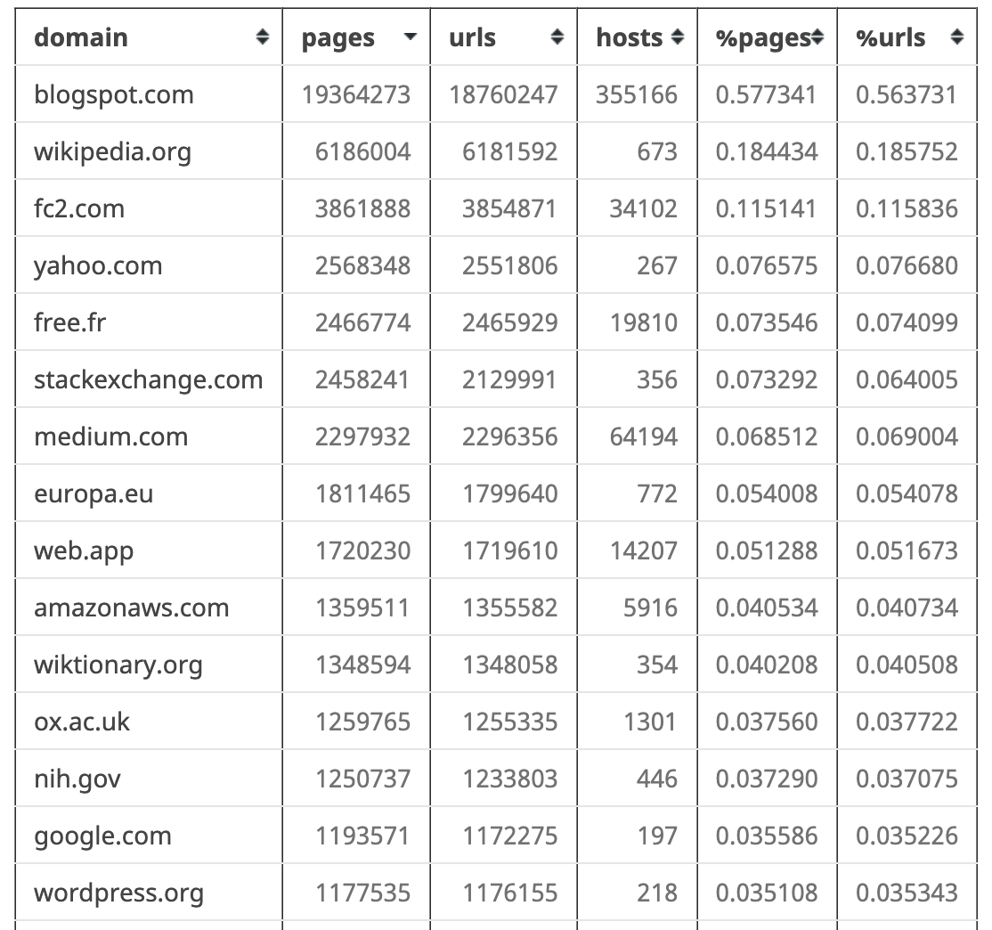
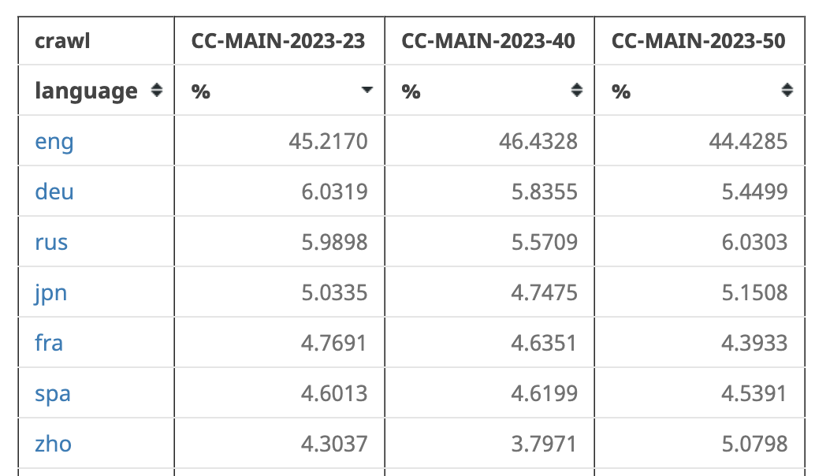
What is it trained on?
Common Crawl (https://commoncrawl.org) – open source dataset of the internet > 120 TB

Slide 6
Training and Output Generation
Also books, news articles (see NYT lawsuit)
The following is from asking chatGPT
Text converted to tokenized input sequence
Add positional information (records token order)
Multi-head self attention (weighting)
Normalization / Feedforward / Layer Normalization
Generating Responses
Starts with the prompt
Language Understanding Component – convert to input sequence
Generate and score possible responses, use chat history

Slide 7
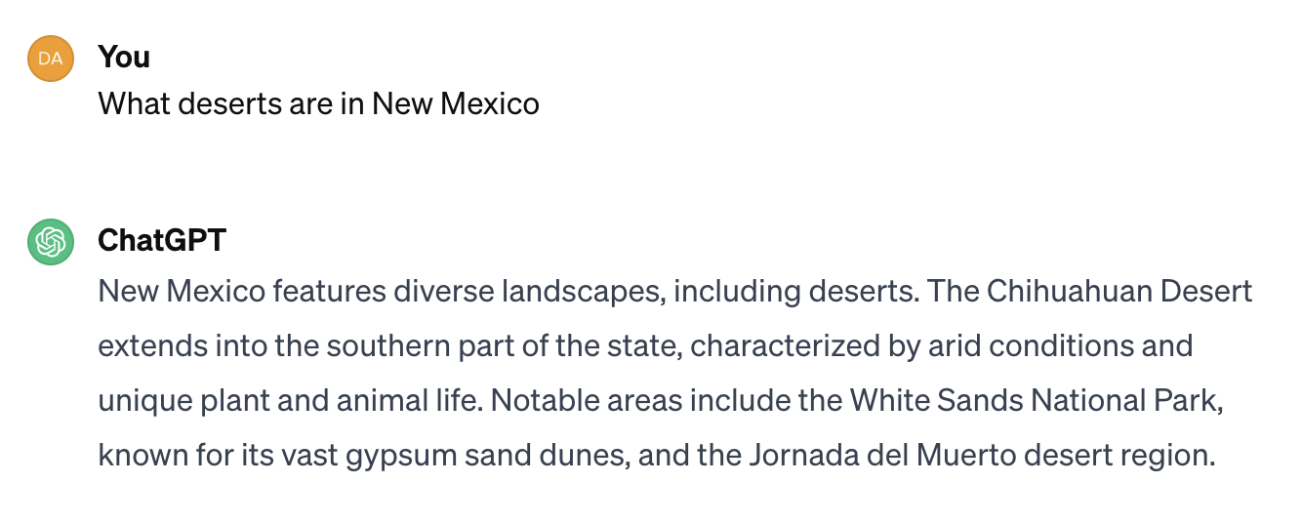
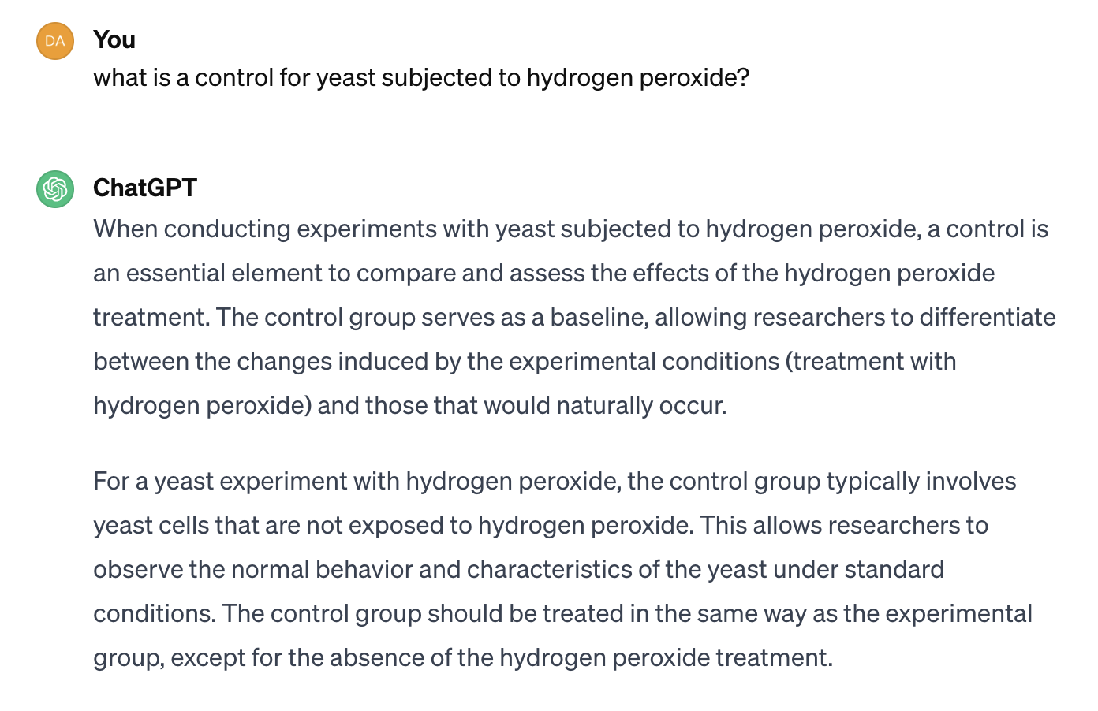
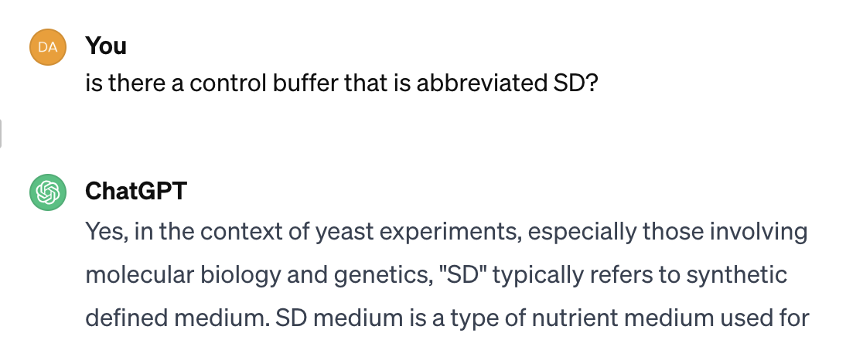
The prompt
Ask/command what you want in plain English
Interactive – chat history is maintained
Examples

Slide 8
platform.openai.com/docs
Scroll down on the left to “guides”
Click “prompt engineering”
Strategy: Write clear instructions
Tactic: Ask the model to adopt a persona
Tactic: Use delimiters to clearly indicate distinct parts of the input
Tactic: Specify the steps required to complete a task
Tactic: Provide examples
Tactic: Specify the desired length of the output

Slide 9
HALLUCINATION
Generated response is not based on fact
From OpenAI safety practices: “Understand and communicate limitations”
CHECK THE RESPONSES
TED Talk: Your brain hallucinates your conscious reality - Anil Seth

Slide 10
How does chatGPT/openAI make money?
GPT 4+: more recent trainings
API:
Text to speech
Speech to text
Image Generation
Vision (“describe this image”
Content moderation (rate text/images)
This script shown located in R repo

Slide 11
Moderation: free
harassment False 0.0002
harassment/threatening False 0.0004
harassment_threatening False 0.0004
hate False 5.939e-07
hate/threatening False 2.640e-07
hate_threatening False 2.640e-07
self-harm True 0.9130
self-harm/instructions False 3.578e-07
self-harm/intent True 0.9423
self_harm True 0.9130
self_harm_instructions False 3.578e-07
self_harm_intent True 0.9423
sexual False 8.066e-05
sexual/minors False 3.134e-07
sexual_minors False 3.134e-07
violence False 0.0563
violence/graphic False 0.0004
violence_graphic False 0.0004
Flagged? True
"Im killing myself with burritos"

Slide 12
Moderation: free
harassment False 0.0005
harassment/threatening False 2.397e-05
harassment_threatening False 2.397e-05
hate False 1.787e-07
hate/threatening False 9.292e-10
hate_threatening False 9.292e-10
self-harm False 4.247e-07
self-harm/instructions False 8.764e-11
self-harm/intent False 1.166e-08
self_harm False 4.247e-07
self_harm_instructions False 8.764e-11
self_harm_intent False 1.166e-08
sexual False 1.629e-05
sexual/minors False 5.406e-10
sexual_minors False 5.406e-10
violence False 0.0003
violence/graphic False 6.787e-06
violence_graphic False 6.787e-06
Flagged? False
"Im stuffing my face with burritos"

Slide 13
Moderation: free
harassment False 0.0042
harassment/threatening False 0.0005
harassment_threatening False 0.0005
hate False 8.709e-06
hate/threatening False 5.093e-07
hate_threatening False 5.093e-07
self-harm False 0.0671
self-harm/instructions False 3.624e-07
self-harm/intent False 0.0016
self_harm False 0.0671
self_harm_instructions False 3.624e-07
self_harm_intent False 0.0016
sexual False 0.0019
sexual/minors False 3.173e-08
sexual_minors False 3.173e-08
violence False 0.1359
violence/graphic False 2.945e-05
violence_graphic False 2.945e-05
Flagged? False
"Im slapping my face with burritos"

Slide 14
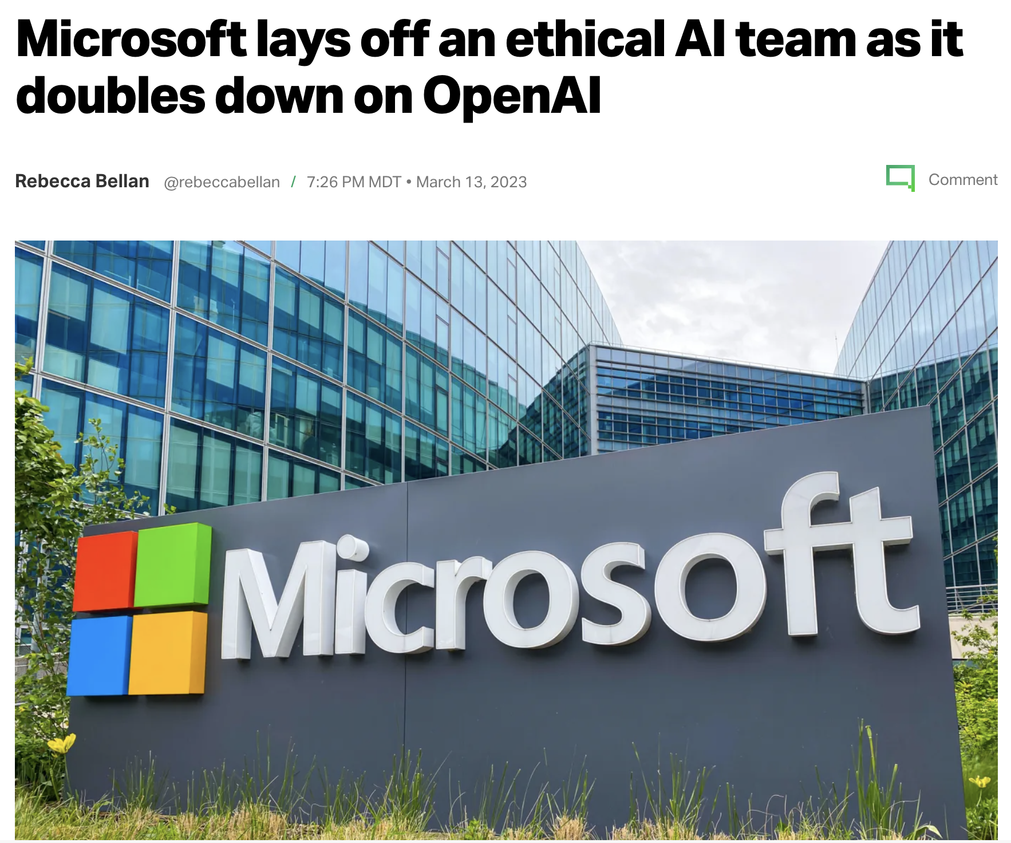
Ethical issues
-www.techcrunch.com

Slide 15
Ethical Issues
Plagiarism
Copyright violation
Replacing a human writer, graphic designer, … researcher?
Using it as a crutch

Slide 16
Ethical issues: replacing a human
Using AI instead of paying a professional
Agreement from Writers strike
“studios ‘cannot use AI to write scripts or to edit scripts that have already been written by a writer’”
“prevents studios from treating AI-generated content as ‘source material’” [then] adapt for a lower fee and less credit than a fully original script.”
Graphic Design
DALL-E
Adobe Firefly
Adobe Illustrator
The Guardian. (2023, October 1). Hollywood writers strike over artificial intelligence. http://tinyurl.com/wga-strike

Slide 17
Ethical issues: Copyright violation
www.copyright.gov:
Copyright is a type of intellectual property that protects original works of authorship as soon as an author fixes the work in a tangible form of expression.
New York Times lawsuit against openAI and Microsoft:
‘Even worse is what the lawsuit calls “regurgitation,” which is when OpenAI spits out text that matches Times articles verbatim. The Times provides 100 examples of such “regurgitation” in the lawsuit. In its rebuttal, OpenAI said that regurgitation is a “rare bug” that the company is “working to drive to zero.” ‘ – vox.com

Slide 18
Ethical Issues: Plagiarism
Passing AI off as your own work
Misrepresents your qualifications
Misrepresents your sincerity
Violates academic integrity

Slide 19

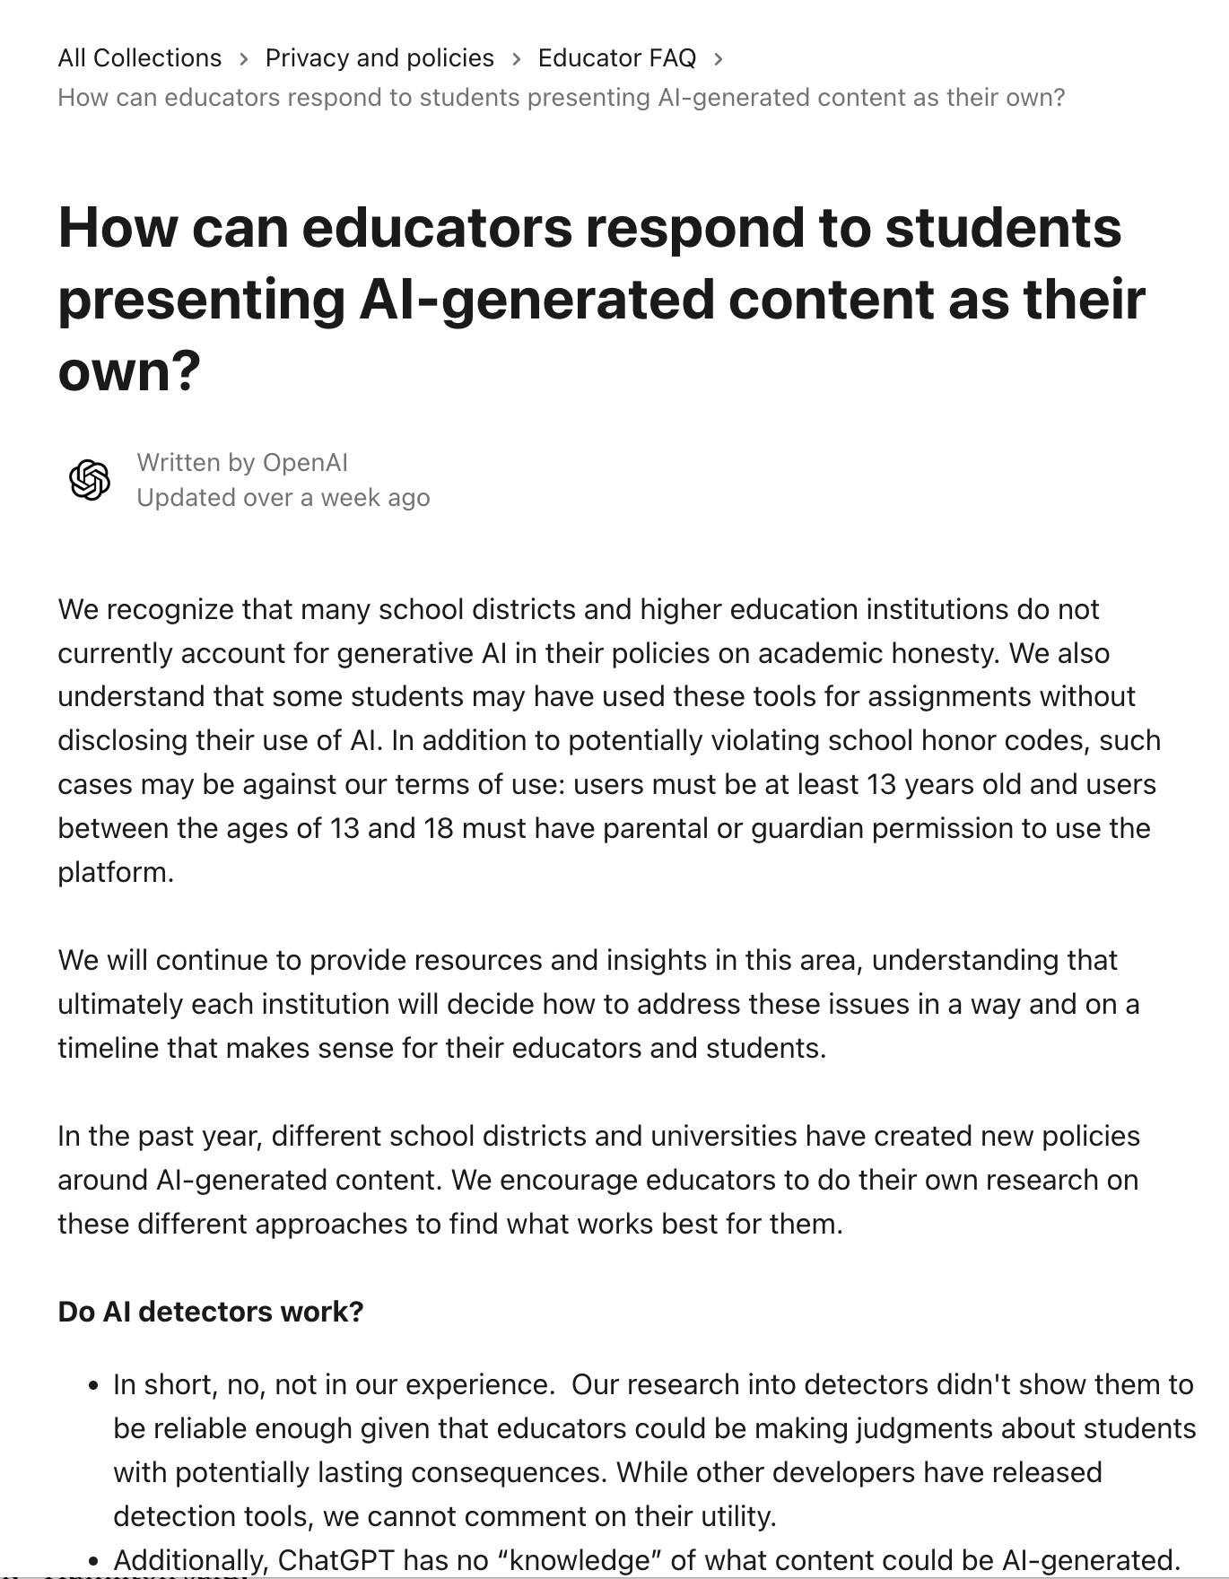
OpenAI’s response

Slide 20
However, there are some approaches that others have found helpful:
One technique some teachers have found useful is encouraging students to share specific conversations from ChatGPT (instructions here). This can have many benefits:
Showing their work and formative assessment:
Educators can analyze student interactions with ChatGPT to observe critical thinking and problem-solving approaches.
Shared links can enable students to review each other's work, fostering a collaborative environment.
By keeping a record of their conversations with AI, students can reflect on their progress over time. They can see how their skills in asking questions, analyzing responses, and integrating information have developed. Teachers can also use these records to provide personalized feedback and support individual growth.
Information and AI literacy:
Students can demonstrate their ability to interact with AI and their understanding of the shortcomings of AI systems. Educators can assess the quality of the questions asked, the relevance of the information obtained, and how well the student understood to challenge, double-check, and consider potential biases in that information.
We anticipate a future where the use of AI tools like ChatGPT is commonplace. Encouraging responsible use helps students prepare for a future where they may be expected to leverage AI in different contexts.
Creating accountability: Sharing interactions with the model ensures that students are held accountable for the way they use AI in their work. Educators can verify that students are engaging with the tool responsibly and meaningfully, rather than simply copying answers.

Slide 21
CODE

Slide 22
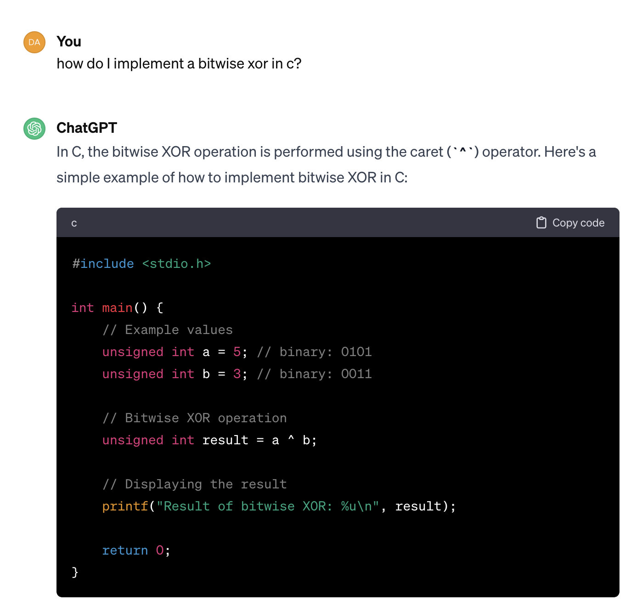
Example
In this example, the bitwise XOR operation is performed on two variables a and b, and the result is stored in the variable result. The printf statement then displays the result.
Keep in mind that the ^ operator works on each bit position independently. If a bit is 1 in either operand, but not both, the corresponding result bit will be set to 1. If a bit is 0 in both operands or 1 in both operands, the corresponding result bit will be set to 0.

Slide 23
Exercises
Writing and code

Slide 24
Writing exercise
Write email text to an advisor. Include something “argumentative”, like you don’t think their idea will work
Initial text: your own voice, can be formal, clunky, not-so-diplomatic
Make it formal
Make it concise
Make it more diplomatic
Prompt: Here is an email message to my advisor. Make it more formal: “write the text”

Slide 25
Coding exercise for R beginners
Prompt: Generate R code to read in a public dataset that doesn’t require installing a separate package.
(I got the wine dataset, and had to make an additional prompt to assign column names)
Prompt: explain the code we wrote to download the wine dataset and assign the column names to someone without any coding background
Prompt: Modify the code to download a different dataset that isn’t built-in to R (otherwise it downloads the iris dataset).

Slide 26
Making an R Markdown from this code
Create an RMarkdown that repeats the steps for the two datasets in code chunks
add raw markdown code to list and explain the columns of the wine dataset

Slide 27
Exercise: you inherit a script from a grad student

